Slide 1
Agents
Smart Game Objects
Programming – Artificial Intelligence for Games

Slide 2
Contents
What is an Agent
Sense, Think, Act
Behaviours
Combining Behaviours
Basic Implementation

Slide 3
What is an Agent?
An Agent is a game object that has some sort of intelligent behaviour and or decision making process
There are 3 common steps which are repeated during an agents “update” process
Sense
Think
Act

Slide 4
Sense
The sense step is where the agent analyses the world and checks for changes to the environment
This could include, but not limited to:
Detecting potential future collisions
Detecting changes in behaviour of other agents
Are other friendly agents in-danger?
Calculating values such as “Hungriness”, “Scaredness” and other such values that could be plugged into a “fuzzy logic” system
Where any sounds played near by that the agent may want to respond to
This step just collects the information required to make a decision during the “Think” step

Slide 5
Think
Once the agent has gathered information, it can now be evaluated and a decision can be made
This step can be incredibly simple or insanely complex
This could consist of handcrafted if-then rules to determine which behaviour should be used, through to a more complex decision making process utilising various AI systems such as:
Fuzzy Logic
Decision/Behaviour Trees
Machine Learning algorithms

Slide 6
Act
Until now, the end user will not have been able to witness the slew of decisions that have been made
The Act step is used to preform the appropriate behaviour that had been calculated during the “Think” step
For example: if the think step decided that a “Seek” behaviour should be used, than the “Act” step will preform the seek operation

Slide 7
Behaviours
Agents should have the ability to change between various different behaviours
We can think of a behaviour as logic used to preform a single task
For example:
Seek, Flee, Wander, Follow Path, Avoid, Patrol
ShootWhenInRange, DropBomb, ClimbLadder, CollectItems<type>

Slide 8
Combining Behaviours
It should be possible to combine behaviours together which will assist with making an agent appear more intelligent
For example:
Seek – seek toward player
Flee – flee from enemy objects (except player)
ShootWhenInRange – if the player is in range, shoot at it

Slide 9
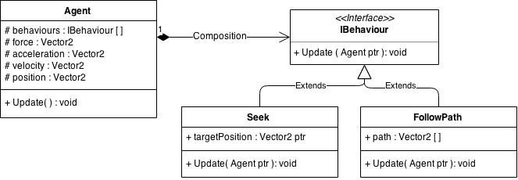
Basic Implementation
Its common practice to wrap an individual behaviour into a single class
We define an abstract Behaviour class for all other behaviours to extend
An Agent or GameObject can have a collection of behaviours
During each frame of our application we run an update on the agent that would update all of the behaviours attached to the object

Slide 10
Basic Implementation (C++)
class GameObject {
public:
virtual void update( float deltaTime ) {
for (auto& behaviour : m_behaviours)
behaviour->update(this, deltaTime);
//TODO: Physics stuff with force, acceleration, velocity etc...
}
protected:
std::list< IBehaviour * > m_behaviours;
Vector2 m_force;
Vector2 m_acceleration;
Vector2 m_velocity;
Vector2 m_position;
};
class IBehaviour {
virtual bool update( GameObject* agent, float deltaTime ) = 0;
};
class Seek : public IBehaviour {
Vector2* m_targetPos;
virtual bool update( GameObject* agent, float deltaTime ) {
// TODO: apply seek force to agent
return true;
}
};

Slide 11
Other Uses
With this particular implementation, we can create behaviours that aren’t necessarily classified as AI
For example:
We could create a “KeyboardController” behaviour, which collects input from the user and moves the Agent based on keyboard input

Slide 12
Other Uses
We could create a behaviour with a single set of properties that is shared amongst multiple Agents
For example, you may have a collection of agents who are following the same path
They could all share the same “Follow Path” behaviour instance
You will want to look at using smart pointers when sharing behaviours, as no single agent will have ownership over the behaviour

Slide 13
Summary
Agents are game objects with intelligent-like behaviour or decision making abilities
The 3 steps – sense, think, act – are repeated during an agent’s update process
Agents should be able to change between various behaviours and combine behaviours
Can make agents appear more intelligent
Many things can be agents, not just in-game NPCs, such as game systems

Slide 14
Further Reading
Rabin, S, 2009, Introduction to Game Development, 2nd Edition, Charles River Media
Millington, I, 2009, Artificial Intelligence for Games, 2nd Edition, CRC Press

